Slide 1
Complexity
Presented By
Dr. Nagaratna P Hegde
Professor, CSE DEPT.
VCE, HYDERABAD

Slide 2
Space Complexity
S(P)=C+S_{P}(I)
Fixed Space Requirements (C)
Independent of the characteristics of the inputs and outputs
  instruction space
  space for simple variables, fixed-size structured variable, constants
Variable Space Requirements (S_{P}(I))
depend on the instance characteristic I
  number, size, values of inputs and outputs associated with I
  recursive stack space, formal parameters, local variables, return address
CHAPTER 1

Slide 3
*Program 1.9: Simple arithmetic function (p.19) float abc(float a, float b, float c)
{ return a + b + b * c + (a + b - c) / (a + b) + 4.00;
}
*Program 1.10: Iterative function for summing a list of numbers (p.20) float sum(float list[ ], int n)
{ float tempsum = 0; int i; for (i = 0; i<n; i++) tempsum += list [i]; return tempsum;
}
S_{abc}(I) = 0
S_{sum}(I) = 0
Recall: pass the address of the
first element of the array &
pass by value
CHAPTER 1

Slide 4
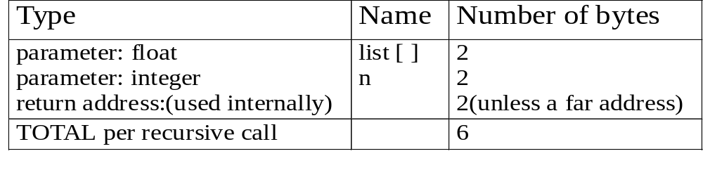
*Program 1.11: Recursive function for summing a list of numbers (p.20) float rsum(float list[ ], int n)
{ if (n) return rsum(list, n-1) + list[n-1]; return 0;
}
*Figure 1.1: Space needed for one recursive call of Program 1.11 (p.21)
S_{sum}(I)=S_{sum}(n)=6n
Assumptions:
CHAPTER 1

Slide 5
Time Complexity
T(P)=C+T_{P}(I)
Compile time (C)
independent of instance characteristics
run (execution) time T_{P}
Definition
A program step is a syntactically or semantically meaningful program segment whose execution time is independent of the instance characteristics.
Example
  abc = a + b + b * c + (a + b - c) / (a + b) + 4.0
  abc = a + b + c
T_{P}(n)=c_{a}ADD(n)+c_{s}SUB(n)+c_{l}LDA(n)+c_{st}STA(n)
Regard as the same unit
machine independent
CHAPTER 1

Slide 6
Methods to compute the step count
Introduce variable count into programs
Tabular method
  Determine the total number of steps contributed by each statement
  step per execution × frequency
  add up the contribution of all statements
CHAPTER 1

Slide 7
*Program 1.12: Program 1.10 with count statements (p.23) float sum(float list[ ], int n)
{ float tempsum = 0; count++; /* for assignment */ int i; for (i = 0; i < n; i++) { count++; /*for the for loop */ tempsum += list[i]; count++; /* for assignment */
} count++; /* last execution of for */ return tempsum; count++; /* for return */
}
Iterative summing of a list of numbers
2n + 3 steps
CHAPTER 1

Slide 8
*Program 1.13: Simplified version of Program 1.12 (p.23) float sum(float list[ ], int n)
{ float tempsum = 0; int i; for (i = 0; i < n; i++) count += 2; count += 3; return 0;
}
2n + 3 steps
CHAPTER 1

Slide 9
*Program 1.14: Program 1.11 with count statements added (p.24) float rsum(float list[ ], int n)
{ count++; /*for if conditional */ if (n) { count++; /* for return and rsum invocation */ return rsum(list, n-1) + list[n-1];
} count++; return list[0];
}
Recursive summing of a list of numbers
2n+2
CHAPTER 1

Slide 10
*Program 1.15: Matrix addition (p.25) void add( int a[ ] [MAX_SIZE], int b[ ] [MAX_SIZE], int c [ ] [MAX_SIZE], int rows, int cols)
{ int i, j; for (i = 0; i < rows; i++) for (j= 0; j < cols; j++) c[i][j] = a[i][j] +b[i][j];
}
Matrix addition
CHAPTER 1

Slide 11
*Program 1.16: Matrix addition with count statements (p.25) void add(int a[ ][MAX_SIZE], int b[ ][MAX_SIZE], int c[ ][MAX_SIZE], int row, int cols )
{ int i, j; for (i = 0; i < rows; i++){ rows+1 count++; /* for i for loop */ for (j = 0; j < cols; j++) { (cols+1)rows count++; /* for j for loop */ c[i][j] = a[i][j] + b[i][j]; (cols)rows count++; /* for assignment statement */
} count++; /* last time of j for loop */
} count++; /* last time of i for loop */
}
2rows * cols + 2 rows + 1
CHAPTER 1

Slide 12
*Program 1.17: Simplification of Program 1.16 (p.26) void add(int a[ ][MAX_SIZE], int b [ ][MAX_SIZE], int c[ ][MAX_SIZE], int rows, int cols)
{ int i, j; for( i = 0; i < rows; i++) { for (j = 0; j < cols; j++) count += 2; count += 2;
} count++;
}
2rows × cols + 2rows +1
Suggestion: Interchange the loops when rows >> cols
CHAPTER 1

Slide 13
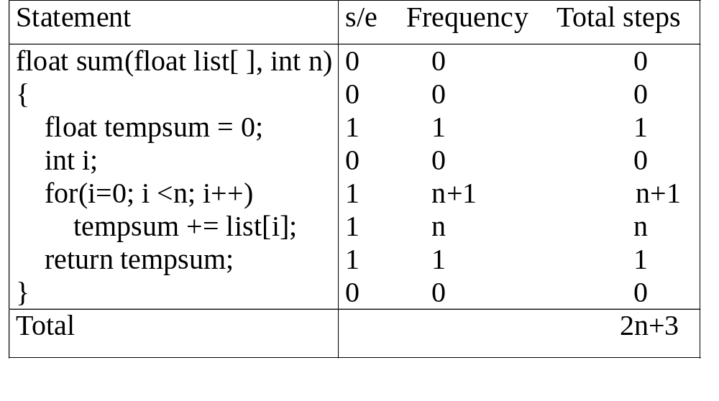
*
Tabular Method
CHAPTER 1

Slide 14
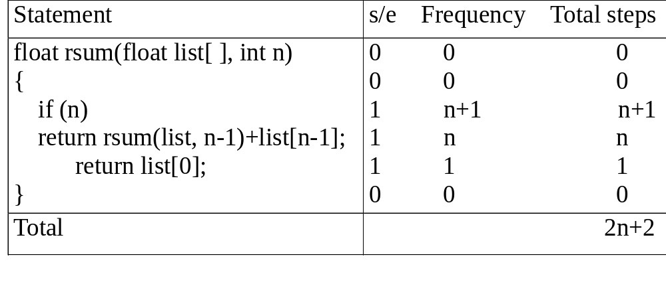
*Figure 1.3: Step count table for recursive summing function (p.27)
Recursive Function to sum of a list of numbers
CHAPTER 1

Slide 15
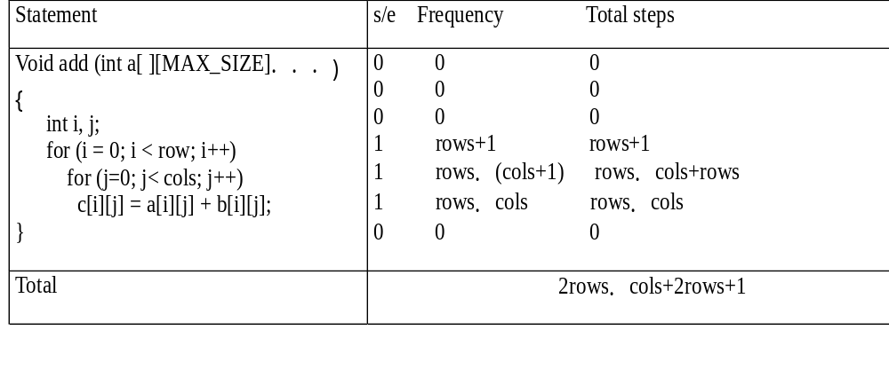
*
Matrix Addition
CHAPTER 1

Slide 16
*Program 1.18: Printing out a matrix (p.28) void print_matrix(int matrix[ ][MAX_SIZE], int rows, int cols)
{ int i, j; for (i = 0; i < row; i++) { for (j = 0; j < cols; j++) printf(“%d”, matrix[i][j]); printf( “\n”);
}
}
Exercise 1
CHAPTER 1

Slide 17
*Program 1.19:Matrix multiplication function(p.28) void mult(int a[ ][MAX_SIZE], int b[ ][MAX_SIZE], int c[ ][MAX_SIZE])
{ int i, j, k; for (i = 0; i < MAX_SIZE; i++) for (j = 0; j< MAX_SIZE; j++) { c[i][j] = 0; for (k = 0; k < MAX_SIZE; k++) c[i][j] += a[i][k] * b[k][j];
}
}
Exercise 2
CHAPTER 1

Slide 18
*Program 1.20:Matrix product function(p.29) void prod(int a[ ][MAX_SIZE], int b[ ][MAX_SIZE], int c[ ][MAX_SIZE], int rowsa, int colsb, int colsa)
{ int i, j, k; for (i = 0; i < rowsa; i++) for (j = 0; j< colsb; j++) { c[i][j] = 0; for (k = 0; k< colsa; k++) c[i][j] += a[i][k] * b[k][j];
}
}
Exercise 3
CHAPTER 1

Slide 19
*Program 1.21:Matrix transposition function (p.29) void transpose(int a[ ][MAX_SIZE])
{ int i, j, temp; for (i = 0; i < MAX_SIZE-1; i++) for (j = i+1; j < MAX_SIZE; j++)
SWAP (a[i][j], a[j][i], temp);
}
Exercise 4
CHAPTER 1

Slide 20
Asymptotic Notation (O)
Definition
f(n) = O(g(n)) iff there exist positive constants c and n₀ such that f(n) ≤ cg(n) for all n, n ≥ n₀.
Examples
  3n+2=O(n) /* 3n+2≤4n for n≥2 */
  3n+3=O(n) /* 3n+3≤4n for n≥3 */
  100n+6=O(n) /* 100n+6≤101n for n≥10 */
  10n²+4n+2=O(n²) /* 10n²+4n+2≤11n² for n≥5 */
  6*2^{n}+n²=O(2^{n}) /* 6*2^{n}+n² ≤7*2^{n} for n≥4 */
CHAPTER 1

Slide 21
Example
Complexity of c₁n²+c₂n and c₃n
  for sufficiently large of value, c₃n is faster than c₁n²+c₂n
  for small values of n, either could be faster
    c₁=1, c₂=2, c₃=100 --> c₁n²+c₂n ≤ c₃n for n ≤ 98
    c₁=1, c₂=2, c₃=1000 --> c₁n²+c₂n ≤ c₃n for n ≤ 998
  break even point
    no matter what the values of c1, c2, and c3, the n beyond which c₃n is always faster than c₁n²+c₂n
CHAPTER 1

Slide 22
O(1): constant
O(n): linear
O(n²): quadratic
O(n³): cubic
O(2^{n}): exponential
O(logn)
O(nlogn)
CHAPTER 1

Slide 23
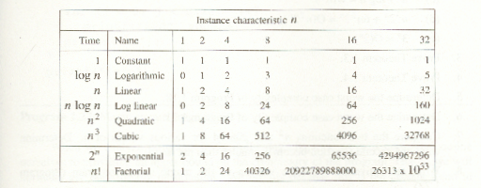
*Figure 1.7:Function values (p.38)
CHAPTER 1

Slide 24
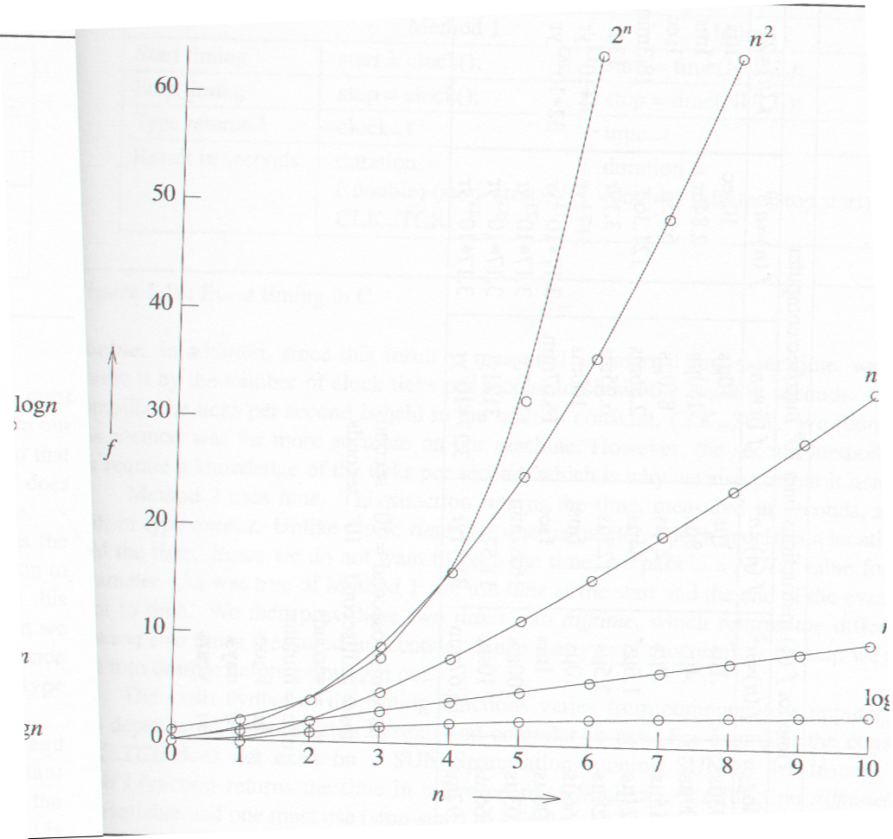
*Figure 1.8:Plot of function values(p.39)
nlogn
n
logn
CHAPTER 1

Slide 25
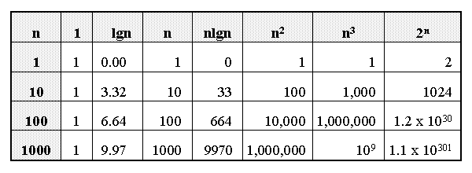

Slide 26
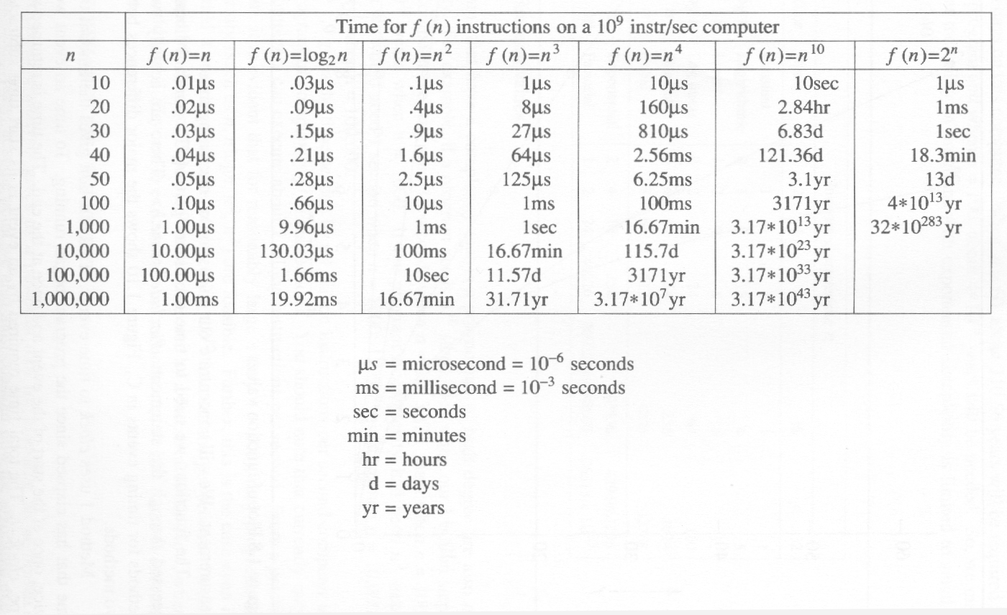
*Figure 1.9:Times on a 1 billion instruction per second computer(p.40)
CHAPTER 1

Slide 27
Classifying functions by their
Asymptotic Growth Rates (2/2)
O(g(n)), Big-Oh of g of n, the Asymptotic Upper Bound;
Θ(g(n)), Theta of g of n, the Asymptotic Tight Bound; and
Ω(g(n)), Omega of g of n, the Asymptotic Lower Bound.
Notes:
asymptotically tight bound: Definition: When the asymptotic complexity of an algorithm exactly matches the theoretically proved asymptotic complexity of the corresponding problem. Informally, when an algorithm solves a problem at the theoretical minimum.

Slide 28
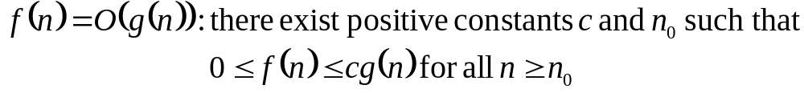
Big-O
What does it mean?
  If f(n) = O(n²), then:
    f(n) can be larger than n² sometimes, but…
    We can choose some constant c and some value n₀ such that for every value of n larger than n₀ : f(n) < cn²
    That is, for values larger than n₀, f(n) is never more than a constant multiplier greater than n²
    Or, in other words, f(n) does not grow more than a constant factor faster than n².

Slide 29
Visualization of O(g(n))
cg(n)
f(n)
n₀

Slide 30
Examples
2n² ≤ cn³ ⇒ 2 ≤ cn ⇒ c = 1 and n₀= 2
  2n² = O(n³):
  n² = O(n²):
  1000n²+1000n = O(n²):
  n = O(n²):
n² ≤ cn² ⇒ c ≥ 1 ⇒ c = 1 and n₀= 1
1000n²+1000n ≤ cn² ≤ cn²+ 1000n ⇒ c=1001 and n₀ = 1
n ≤ cn² ⇒ cn ≥ 1 ⇒ c = 1 and n₀= 1

Slide 31
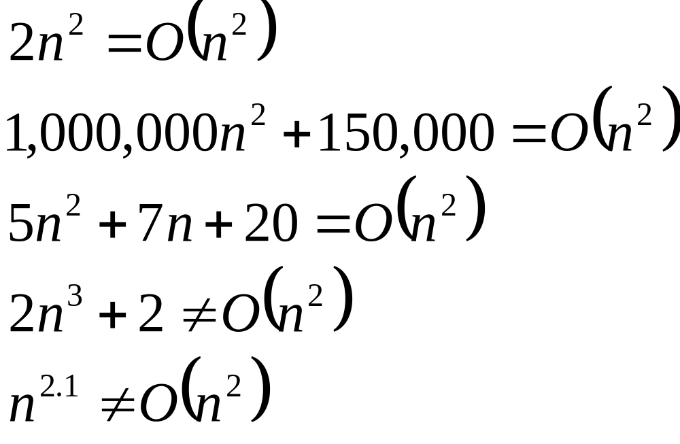
Big-O

Slide 32
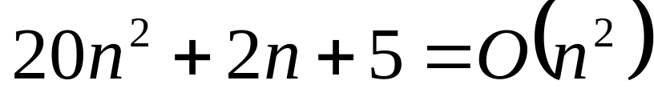
More Big-O
Prove that:
Let c = 21 and n₀ = 4
21n² > 20n² + 2n + 5 for all n > 4
n² > 2n + 5 for all n > 4
TRUE

Slide 33
Tight bounds
We generally want the tightest bound we can find.
While it is true that n² + 7n is in O(n³), it is more interesting to say that it is in O(n²)

Slide 34

Big Omega – Notation
Ω() – A lower bound
  n² = Ω(n)
  Let c = 1, n₀ = 2
  For all n ≥ 2, n² > 1 × n

Slide 35
Visualization of Ω(g(n))
f(n)
cg(n)
n₀

Slide 36
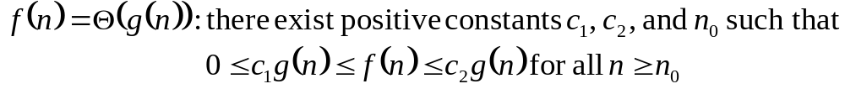
Θ-notation
Big-O is not a tight upper bound. In other words n = O(n²)
Θ provides a tight bound
In other words,

Slide 37
Visualization of Θ(g(n))
c₂g(n)
f(n)
c₁g(n)
n₀

Slide 38
A Few More Examples
n = O(n²) ≠ Θ(n²)
200n² = O(n²) = Θ(n²)
n^{2.5} ≠ O(n²) ≠ Θ(n²)

Slide 39
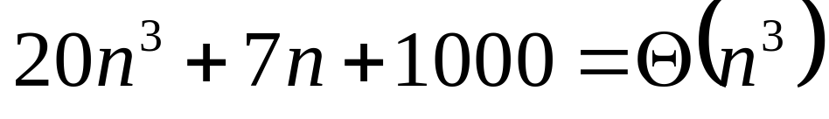
Example 2
Prove that:
Let c = 21 and n₀ = 10
21n³ > 20n³ + 7n + 1000 for all n > 10
n³ > 7n + 5 for all n > 10
TRUE, but we also need…
Let c = 20 and n₀ = 1
20n³ < 20n³ + 7n + 1000 for all n ≥ 1
TRUE

Slide 40
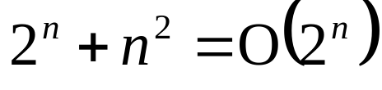
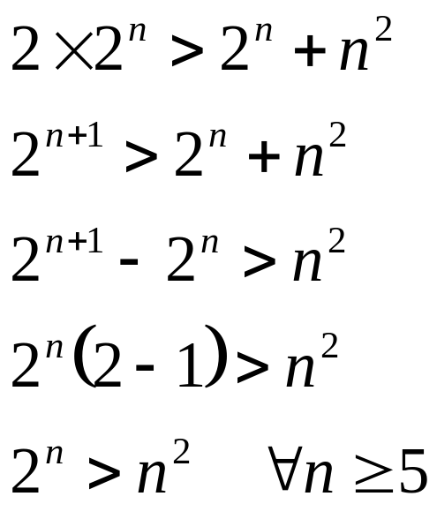
Example 3
Show that
Let c = 2 and n₀ = 5
✓

Slide 41
Asymptotic Notations - Examples
Θ notation
  n²/2 – n/2
  (6n³ + 1)lgn/(n + 1)
  n vs. n²
Ω notation
  n³ vs. n²
  n vs. logn
  n vs. n²
= Θ(n²)
= Θ(n²lgn)
n ≠ Θ(n²)
O notation
  2n² vs. n³
  n² vs. n²
  n³ vs. nlogn
n³ = Ω(n²)
2n² = O(n³)
n = Ω(logn)
n² = O(n²)
n ≠ Ω(n²)
n³ ≠ O(nlgn)

Slide 42
Asymptotic Notations - Examples
For each of the following pairs of functions, either f(n) is O(g(n)), f(n) is Ω(g(n)), or f(n) = Θ(g(n)). Determine which relationship is correct.
  f(n) = log n²; g(n) = log n + 5
  f(n) = n; g(n) = log n²
  f(n) = log log n; g(n) = log n
  f(n) = n; g(n) = log² n
  f(n) = n log n + n; g(n) = log n
  f(n) = 10; g(n) = log 10
  f(n) = 2^{n}; g(n) = 10n²
  f(n) = 2^{n}; g(n) = 3^{n}
f(n) = Θ (g(n))
f(n) = Ω(g(n))
f(n) = O(g(n))
f(n) = Ω(g(n))
f(n) = Ω(g(n))
f(n) = Θ(g(n))
f(n) = Ω(g(n))
f(n) = O(g(n))

Slide 43
Simplifying Assumptions
1. If f(n) = O(g(n)) and g(n) = O(h(n)), then f(n) = O(h(n))
2. If f(n) = O(kg(n)) for any k > 0, then f(n) = O(g(n))
3. If f₁(n) = O(g₁(n)) and f₂(n) = O(g₂(n)),
then f₁(n) + f₂(n) = O(max (g₁(n), g₂(n)))
4. If f₁(n) = O(g₁(n)) and f₂(n) = O(g₂(n)),
then f₁(n) * f₂(n) = O(g₁(n) * g₂(n))

Slide 44
Example #1: carry n items from one room to another room
How many operations?
n pick-ups, n forward moves, n drops and n reverse moves → 4 n operations
4n operations = c. n = O(c. n) = O(n)
Similarly, any program that reads n inputs from the user will have minimum time complexity O(n).

Slide 45
Example #2: Locating patient record in
Doctor Office
What is the time complexity of search?
Binary Search algorithm at work
O(log n)
Sequential search?
O(n)

Slide 46
Example #3: Store manager gives gifts to first 10 customers
There are n customers in the queue.
Manager brings one gift at a time.
Time complexity = O(c. 10) = O(1)
Manager will take exactly same time irrespective of the line length.

Slide 47
Loops with Break
for (j = 0; j < n; ++j) {
// 3 atomics
if (condition) break;
}
Upper bound = O(4n) = O(n)
Lower bound = Ω(4) = Ω(1)
Complexity = O(n)
Home Work Ques: Why don’t we have a Θ(…) notation here?

